Slide 1
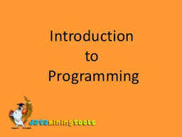
Chapter 1 Review

Slide 2
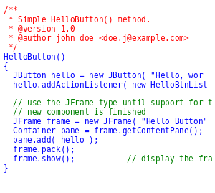
Question: What are programs?

Slide 3

Answer: What are programs?
Directions or instructions given to a computer.

Slide 4
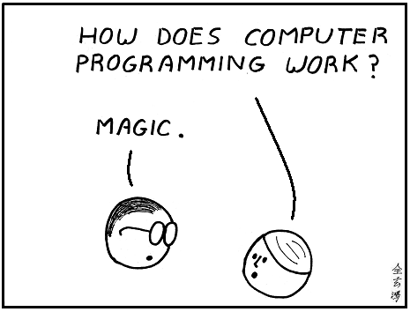
Question: What is coding?

Slide 5
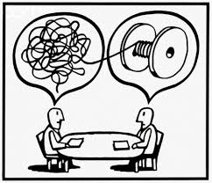
Answer: What is coding?
Translating a solution into a language that a computer can understand.

Slide 6
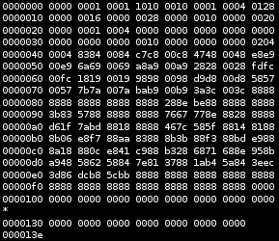
Question: What is machine language?

Slide 7
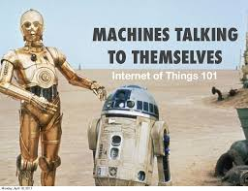
Answer: What is machine language?
Instructions written in 0’s and 1’s.

Slide 8
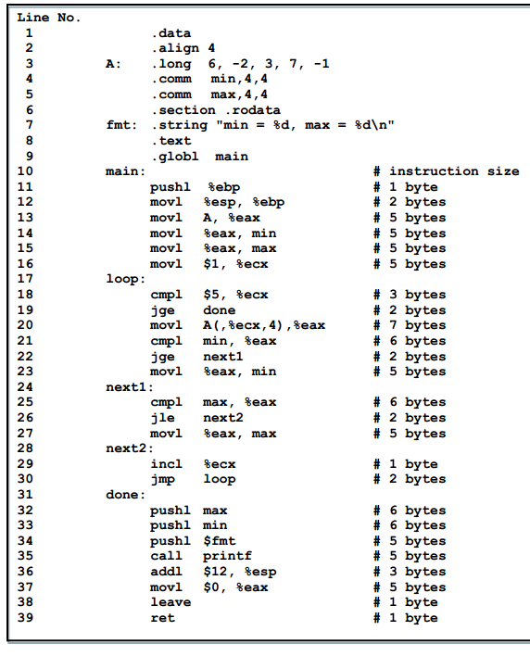
Question: What is Assembly Language?

Slide 9
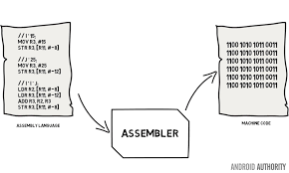
Answer: What is Assembly Language?
Uses mnemonics for memory aids. Simplifies programming. Just above machine language.

Slide 10
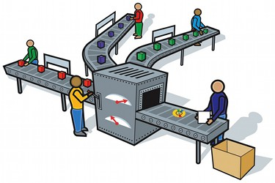
Question: What is an assembler?

Slide 11
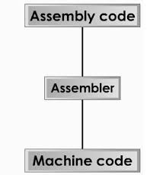
Answer: What is an assembler?
A program that converts assembly instructions into machine code.

Slide 12
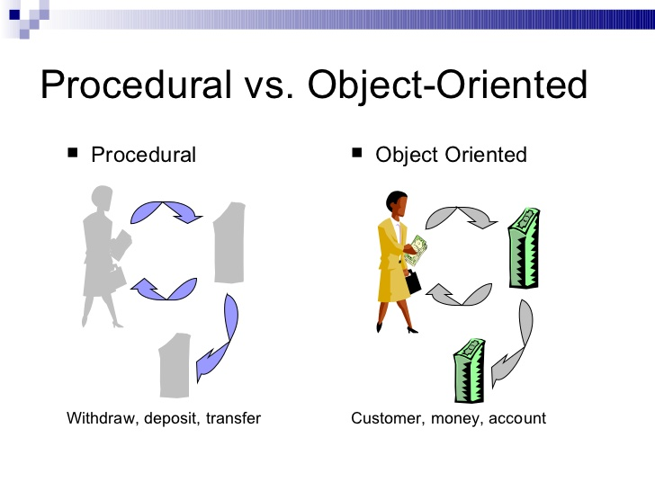
Question: What is procedure –oriented program?

Slide 13
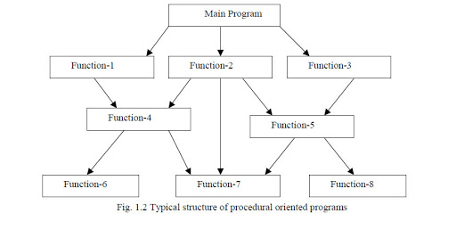
Answer: What is procedure –oriented program?
A procedure-oriented program focusses on the procedures or functions that need to occur. For example, payroll, inventory, paychecks.

Slide 14
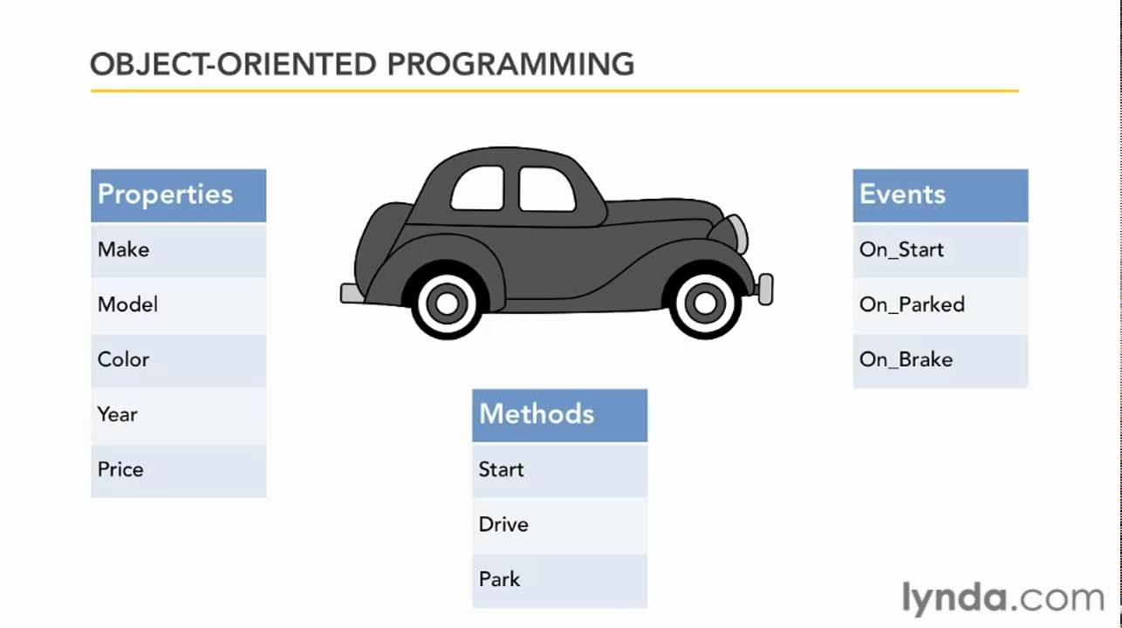
Question: What is an Object Oriented program?

Slide 15
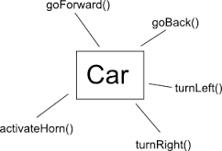
Question: What is an Object Oriented program?

Slide 16
Question: What are programming control structures?
Sequence – the order of execution – all programs have it
Decision - if / else
Repetition – do while, loop, while

Slide 17
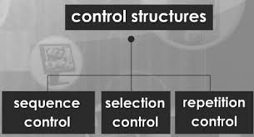
Answer: What are programming control structures?

Slide 18
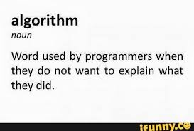
Question: What is an algorithm?
NOT!!!!

Slide 19
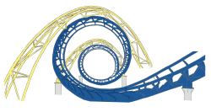
What structure ends when its condition is met?

Slide 20
Answer: What structure ends when its condition is met?

Slide 21
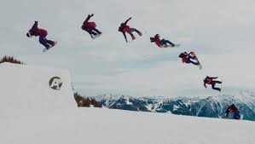
Question: What control structure is in all programs?

Slide 22
Answer: What control structure is in all programs?

Slide 23
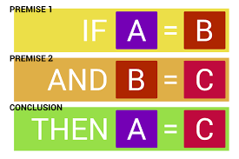
Question: What is a logic structure?

Slide 24
Answer: What is a logic structure?
Same as Control Structures

Slide 25
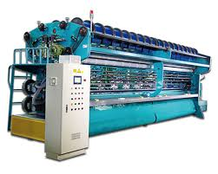
Question 1
Instructions written in 0’s and 1’s are called ---------------------- language.

Slide 26
Answer 1
Instructions written in 0’s and 1’s are called machine language.

Slide 27
Question 2
The three basic control/logic structures are?

Slide 28

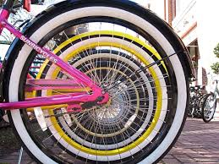

Answer 2
The three basic control/logic structures are:
Sequence, Decision/Selection, and Repetition.

Slide 29
Question 3
Which control structure is in all programs?

Slide 30

Answer 3
Which control structure is in all programs? Sequence

Slide 31
Question 4
The step by step instructions that accomplish a task are called?

Slide 32
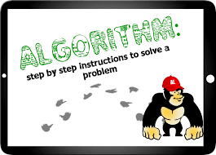
Answer 4
The step by step instructions that accomplish a task are called an?

